Slide 1
Social Networks, Social Media and Disaster Communication
Steven Procopio, Ph.D.
PAR Policy Director

Slide 2
PAR is an independent voice, offering solutions to critical public issues in Louisiana through accurate, objective research and focusing public attention on those solutions.

Slide 3
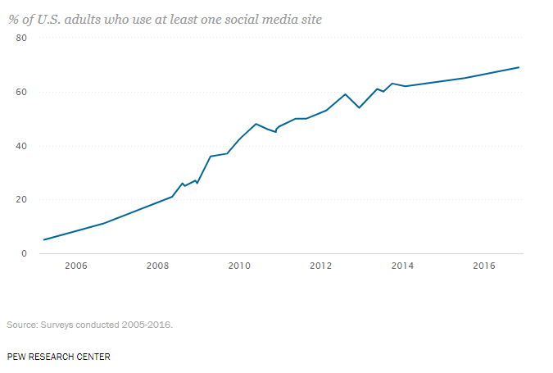
Social Media Use has Skyrocketed
Notes:
2005 5%
2016 69%

Slide 4
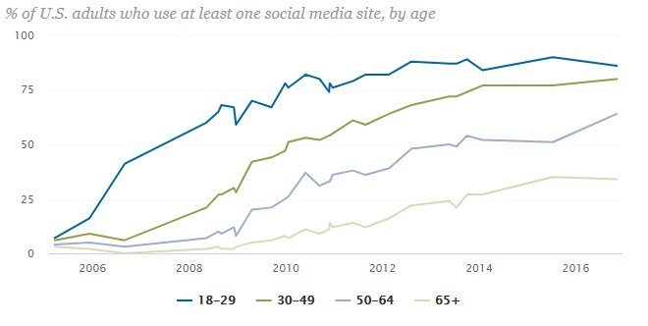
Use Varies by Age
Notes:
65+ 34% 50-64 64% 30-49 80% 18-29 86%
No real other big difference by gender, race or location (rural, urban, suburban)
Some income and education difference

Slide 5

Social Media changes quickly
Notes:
2011 Snapchap
2106 150 million daily users – more than twitter, but less than 1.2 Facebook
Name some social media! Linkdin, Instagram, Pintrest, Reddit, 4chan, forums

Slide 6
What are Social Networks?
Homophily
Multiplexity
Mutuality/Reciprocity
Network Closure
Propinquity
Bridge
Centrality
Density
Distance
Structural holes
Tie Strength
Notes:
3-4 minutes each…
Y’all are so polite! You know what they are, friends and coworkers and people you know and interact with
I will equate SOCIAL NETWORKS with SOCIAL MEDIA electronic method or platform by which that happens
The message is the medium type of thing Get NEWS from TV

Slide 7
Poison Well
Imagine a village with a well with a harmful chemical
20% of the people drinking from the well will get sick
That’s the media
Notes:
Boss is Robert Travis Scott, former political editor of the New Orleans Times Picayune;

Slide 8
Infected Well
Imagine a village with a well with a harmful virus
10% of the people drinking from the well will get sick
10% of those that come in contact with sick people, will also get sick
That’s social networks- can be POWERFUL

Slide 9
Signal Distortion
Serial compounding error
  Each node of communication adds a little error
  Telephone game
  Social media not too bad at this
Confirmation bias
  Read and pass on what you already think
Controversy bias
  More “interesting” information passed on

Slide 10
Friendship paradox
Your friends have more friends than you
Acute issue with Facebook
Related to self-esteem issue
Notes:
How many are on or use Facebook?

Slide 11
Social Capital
“The collective value of all social networks (who people know), and the inclinations that arise from these networks to do things for each other”
Important for democracy and civil society
Health
Education
Notes:
Social Fabric or How communities get stuff done
Thomas Sanders Harvard
A community different than just a bunch of individuals

Slide 12
Bowling Alone
A steady decline in social capital
Lots of culprits:
  Air conditioning
  Women entering the workforce
  Television
  Internet use???
Notes:
Robert Putnam

Slide 13
Geographic vs. Virtual Community
Even if social media can built “virtual” social capital/networks, does it come at the expense of geographic based community?
NOLA website forums after Katrina
Used to bring neighbors together
  Gather information
  Sending information
  Emotional support and encouragement

Slide 14
Summary
Communication tool
Feedback tool
Discussion/Community building tool
Notes:
Computers to play solitaire and keep your recipes in
FEMA guide People should bring laptops- dated
Provide internet access at shelters, now that would be WIFI
Traditional news should set up interactive fora – kinda with facebook

